Slide 1
The ABCs of FBA
Retail arbitrage on amazon

Slide 2
Credit Card Spend
Gift Card Arbitrage
RetailArbitrage
No Overhead
Storage / Expiration / Shipping

Slide 3
Gift Card Arbitrage
RetailArbitrage
Sometimes preferable to direct-from-CC
Always welcome in store
Alternate when GC market floods
Get around CC buying limits with gift cards

Slide 4
Gift Card Arbitrage
RetailArbitrage
Money Order / Serve
(VGCs / MCGCs)
Gift Card Market
(3rd Party)
Amazon
Commission
Commission
Mostly Break Even
Profit: Miles & Points (big)
Mostly Cash Profit
Profit: Miles & Points (small)

Slide 5
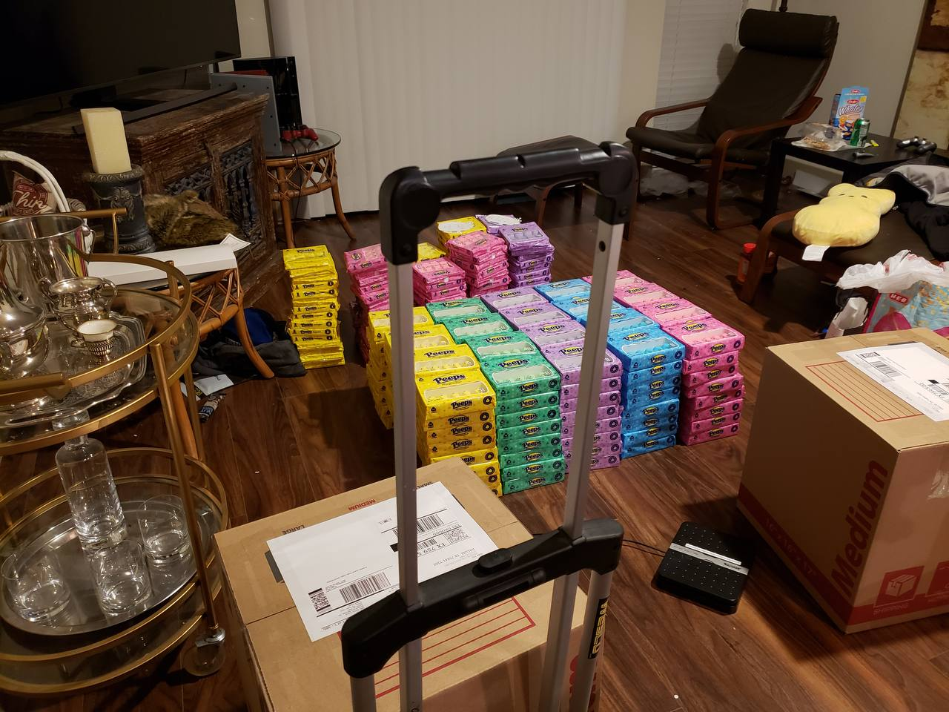

Slide 6
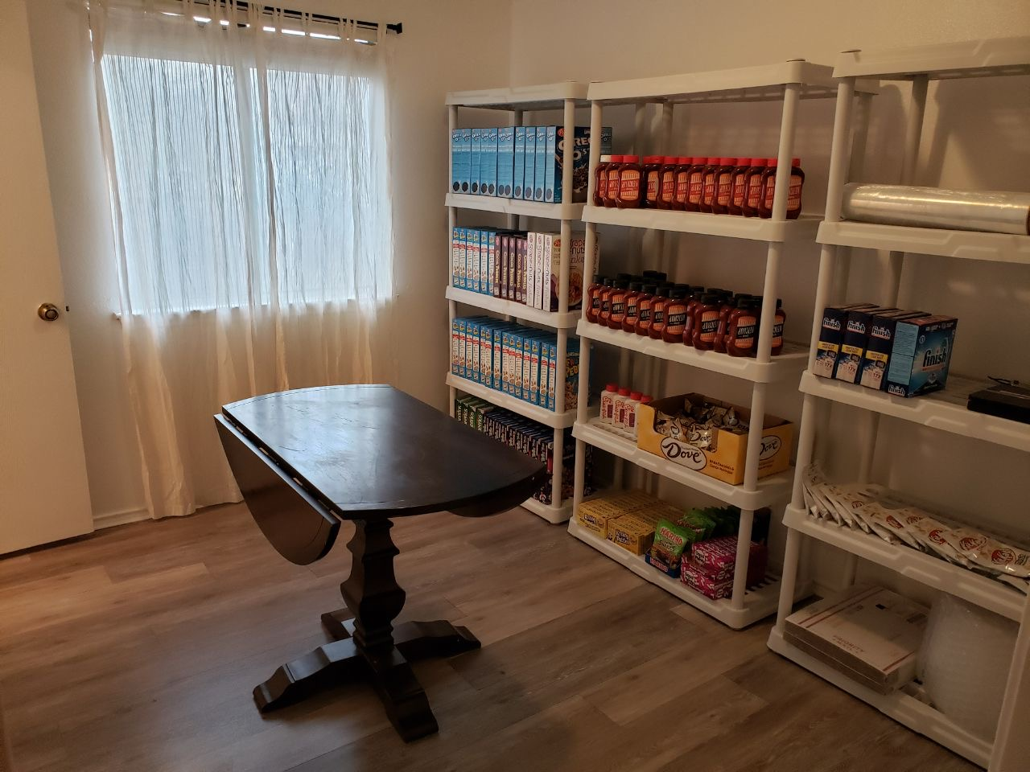

Slide 7
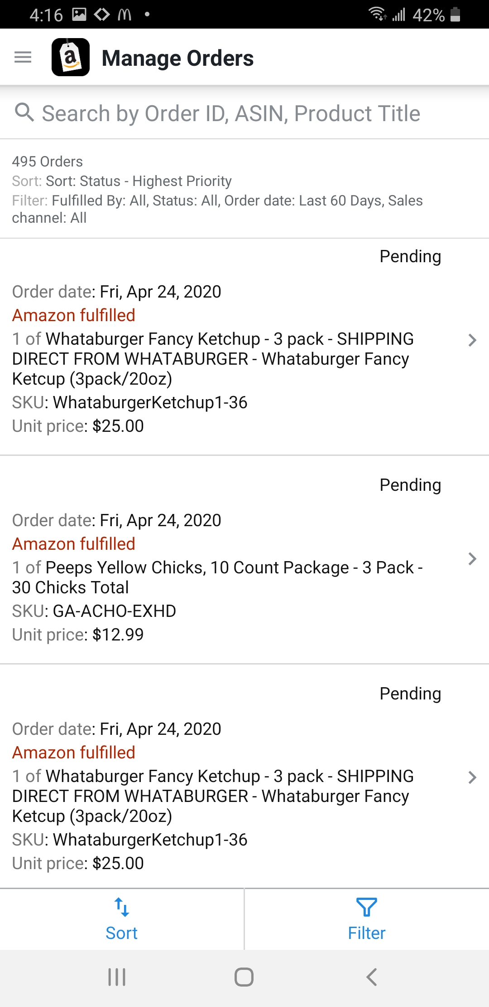
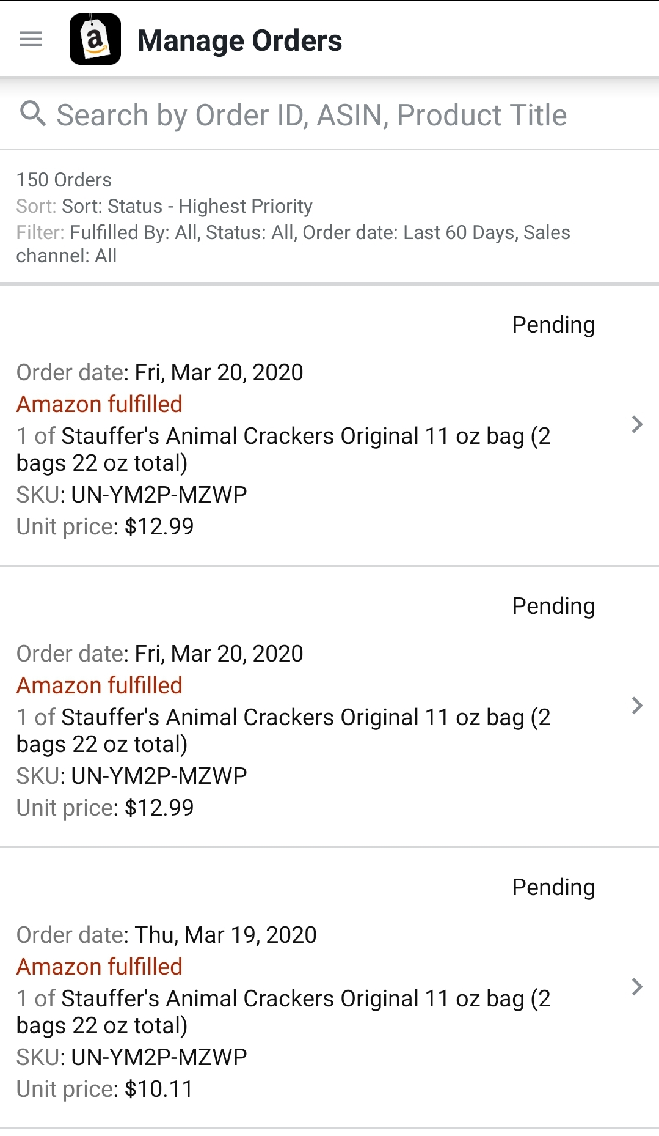
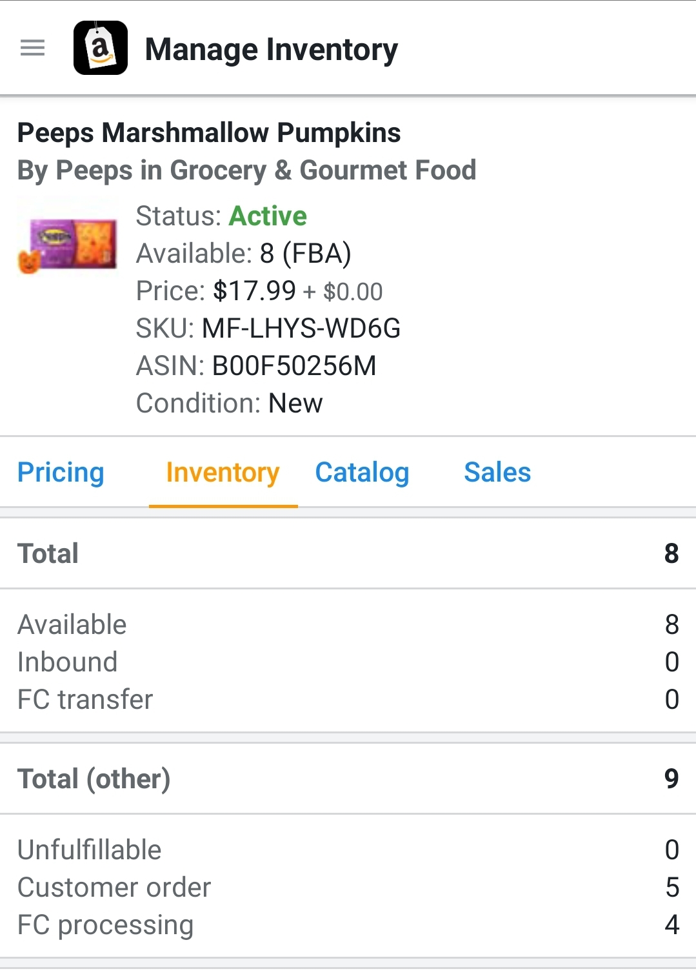

Slide 8
Questions?
Derrick Duck
Telegram: @DerrickDuck
https://duck-deals.com

